Slide 1
Image Processing

Slide 2
Introduction
Visual Information transmitted in the form of digital images is a major method of communication in the modern age, but the image is often corrupted with noise.
The received image needs processing before it can be used in applications.
That is where we come in ;)
Image denoising involves the manipulation of the image data to produce a visually high quality image.

Slide 3
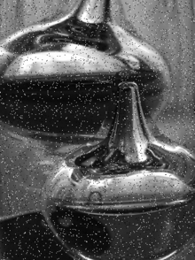
Noise Types:
Salt and Pepper noise
AKA: Intensity Spikes
Results in sparsely occurring white and black pixels
  Hence, Salt and Pepper
Generally caused due to errors in data transmission

Slide 4
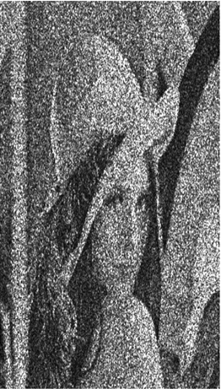
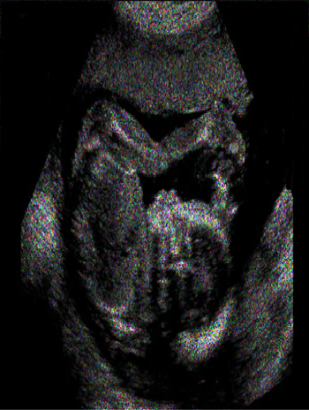
Speckle Noise
The vast majority of the image’s surface are extremely rough on the scale of the wavelength
Obtained from coherent imaging systems, such as :
  Laser
  Synthetic Aperture Radar (SAR)
  Ultrasound imagery

Slide 5
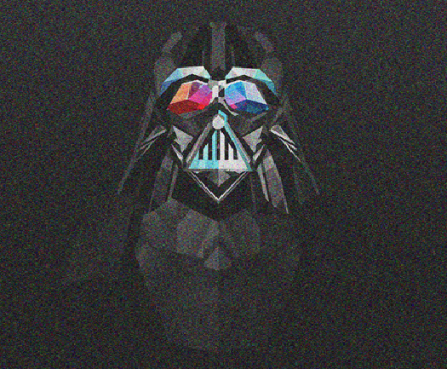
Gaussian Noise
  Clarity’s elected problem
Evenly distributed over the signal
Statistical noise, where the probability density function is equal to the normal distribution
  i.e. Each pixel is the sum of the true pixel and a random Gaussian distributed noise value
So, how do we approach such a problem?

Slide 6
Conclusion/Wrap things up ??
Evidence from the analysis shows that the parallel version is indeed more efficient in comparison to the sequential version
From tests, there was no significant difference in the performance between accessing the 2D array row-wise vs column-wise
  2D array stores pixel pointers, not actual pixel values
  Results in minor idling
Problems
  Inputting in terms of its pixel values
    Resolved by EasyBMP
  Multiplying pixels on the edges by the kernel matrix
    Was dealt with Edge extrapolation
  Finding the optimal kernel matrix
    Each image is unique, Therefore different kernels for different images

Slide 7

Clarity…
Bringing back the OG image, since 2016

